Slide 1
Conducting Inspection of Industries for Prevention & Control of Pollution
Presentation by
Dr. Dilip Boralkar
Environmental Protection Expert,
Ex-Member Secretary MPCB and MZCMA
at
EKF’s Training Programme under Clean Air and Sustainable Environment (CASE) Project under the World Bank
for
The Senior Officers of the Dept. of Environment
Government of Bangladesh
Mumbai, March 25-29, 2019

Slide 2
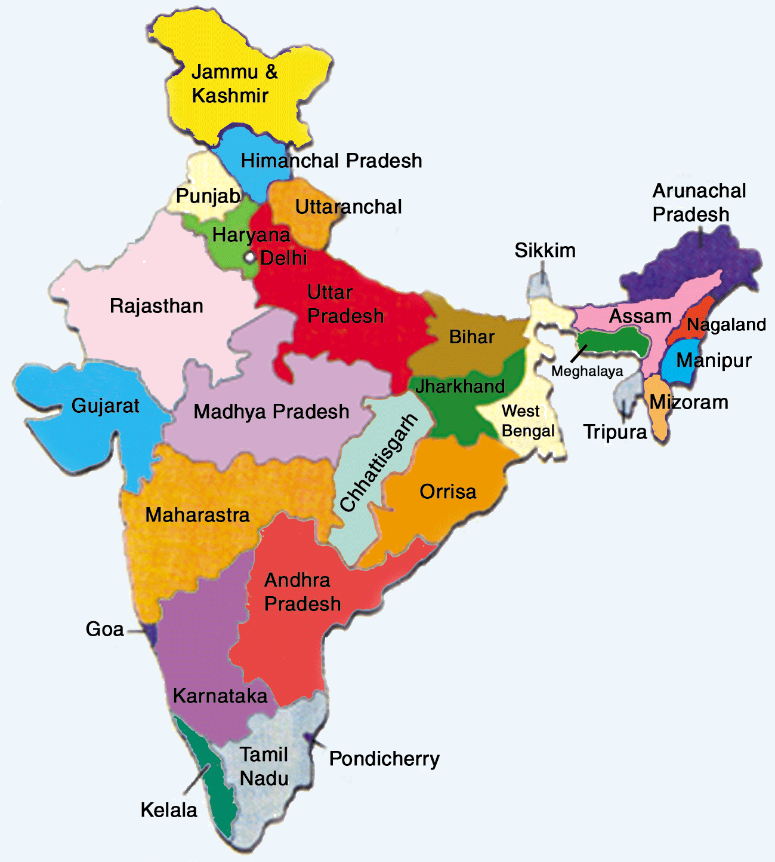
Pollution Control & Environmental Regulation Apparatus in India
MoEF&CC – CPCB – PCC
State Govt. – SPCB
Authorities: EPCA, NCZMA, SEIAA, SCZMA
State Level Committees: SEAC

Slide 3
Functions of the Board
to plan a comprehensive P&CP program and secure the execution
to advise the State Government
to collect and disseminate information
to encourage, conduct and participate in investigations and research
to organise the training and mass education
to inspect sewage or trade effluents, works and treatment plants
to lay down, modify or annul effluent standards
to evolve economical and reliable methods
to evolve methods of utilisation of sewage and suitable trade effluents
to evolve efficient methods of disposal
to make, vary or revoke any order P&CP
…Contd

Slide 4
Functions of the Board
to lay down standards of treatment of sewage and trade effluents to be discharged into any particular stream taking into account the minimum fair weather dilution available in that stream and the tolerance limits of pollution permissible in the water of the stream, after the discharge of such effluents;
to advise the State Government with respect to the location of any industry the carrying on of which is likely to pollute a stream or well;
to establish or recognise a laboratory or laboratories
To perform any other function as may be entrusted by the State or Central Govt.
Establish or recognise a laboratory(s) to enable the Board to perform its functions.

Slide 5
Tools
Power of State & Center (18)
Power of State to restrict application (19)
Power of Entry & Inspection, Obtain information, taking samples, analysis (20, 21, 22, 23)
Prohibition on use of stream or well for disposal (24)
Restriction on new outlets and new discharges (C2E & C2Ou/s25)Refusal (27) (Appeal (28) Revision by State Govt.(29)
Carry out works (30)
Reporting (31) & Emergency Measures (32) Restraining(33) Directions (33A)
…Contd

Slide 6
Tools
Penalties & Procedure: 41:
Failure to comply 20, 3months or with fine 10K
Failure of 33, 1.5 years and may extent up to 6 years with fine 5K/day,
Penalties for Certain Acts: 42 :- 3 months with or without fine for obstruction, destruction, failure to inform etc
Penalty for violation of 24 is under 43:- 1 year to six years with fine
Penalty for violation of 25/26 is under 44: 1.5 to 6 years with fine
…Contd

Slide 7
Tools
Enhance Penalty for repeated violations under 24, 25 or 26:- 2 to 7 tears with fine
Offences by the Govt. Dept. 48: Head of the dept. is liable
Cognizance 49:- No cognizance unless complaint by the Board or officer authorised or any person with 60 days notice
Section 50: Members, Officers and Servants of the Board are deemed Public servants under this Act (45 of 1860) and within the meaning of section 21 of IPC : 50.

Slide 8
Air Pollution Control
Air Pollution Control Area
AAQS (Industrial, Residential Sensitive areas), NAAQM/GEMS
Emission Standards: Conc. and load based, fuel, vehicular emissions, DG set, Stone Crushers, Fly Ash Utilisation, Noise
APCDs
Surveillance monitoring

Slide 9
Water Pollution Control
Standards MINAS,EPA, Recipient Based, Mass Based, Water use restriction (sugar, Refinery)
Compliance by Large & Medium industry
Compliance by SMEs, CETP
Compliance by Local Self Governments (ULBs)
GEMS/MINARS/State level WQM programs

Slide 10
CETP Concept
Wastewater of individual industries often contain significant concentration of pollutants; and techno-economical treatment to reduce them by individual treatment up to the desired concentration is not feasible.
Combined treatment provides a better and economical option.
Also takes care of scarcity of land and trained human resources at the industry's level
For regulatory authorities, it offers a comparatively easier means of ensuring compliance of stipulated norms.
Handling of treated waste also becomes manageable and economical

Slide 11
Common Effluent Treatment Plants
Govt. of India Scheme: 25:25:35:15%
Common Infrastructure forIndustrial clusters comprising SMEs and LSI
Limits (if required) for Primary Treatment, Segregation
Under Ground Drainage for Effluent Conveyance
CETP with supporting units for segregated effluent
Solid Waste Management (TSDF)
Recycle/Reuse of Treated Water
At least 5 years O&M by CETP supplier
Surveillance & Monitoring : On line monitoring of CETP, AAQMS, CCTV for Stacks, Green Belts, All weather roads, etc.
Public Participation: Local Area Environment Committee.

Slide 12
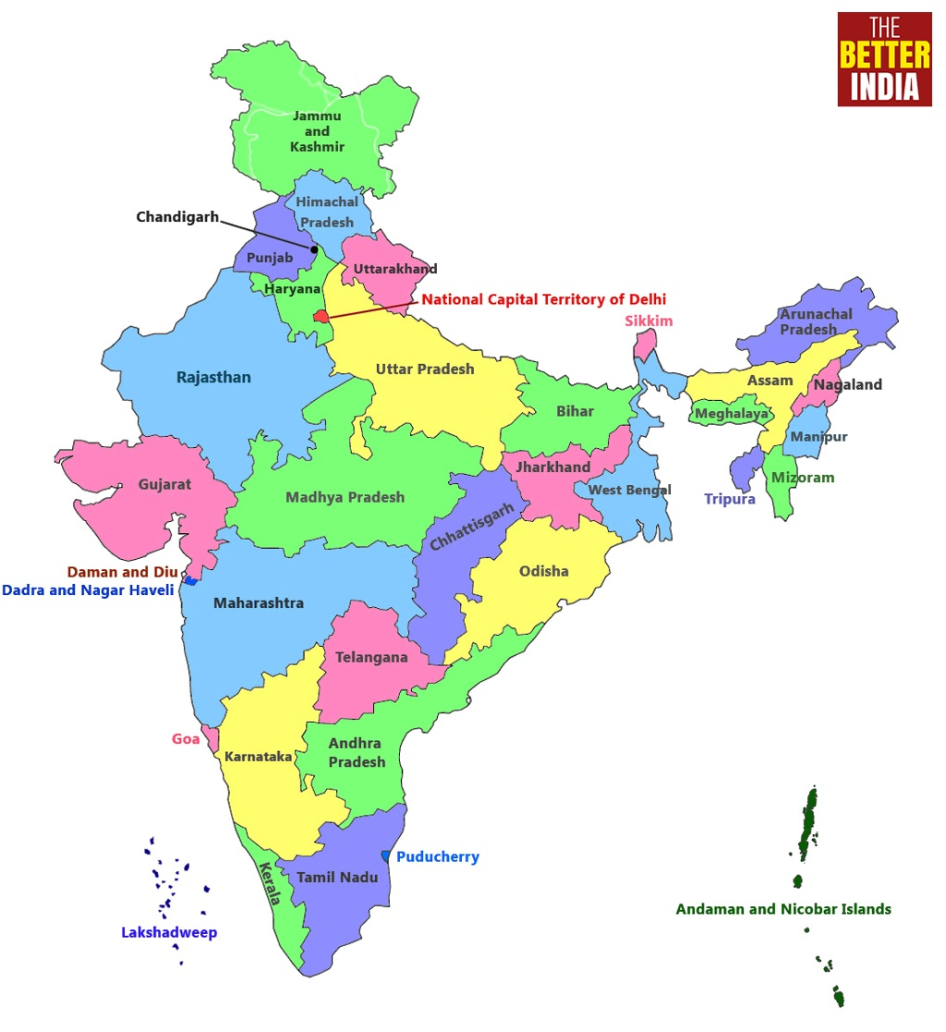
CETPs in Maharashtra State
Location
Capacity
Tarapur: 22 MLD
Kalyan Dombivali: 10 MLD
Ambarnath: 5 MLD
TTC: 25 MLD
Taloja: 22 MLD
Patalganga: 11 MLD
Roha: 10 MLD
Mahad: 10 MLD
Lote Parshuram: 5 MLD
Talegaon: 5 MLD
Ranjangaon: 5 MLD
Waluj: 10 MLD
Buti Bori: 5 MLD
Solapur: 5 MLD
Maharashtra
State

Slide 13
Case Study – Thane – Belapur (Estd. 1997)
Members: SSI 400, Large & Medium 55
Project Finances:
Loan from Financial Institution (IDBI) | : | Rs. 140 lacs
Subsidy from State & Central Govt. | : | Rs. 100 lacs
Contribution from User Members | : | Rs. 160 lacs
Total |  | Rs. 400 lacs
Infrastructures like Drainage Network, Pumping stations, Transformers, Biological Tank and Disposal Pipeline were handed over by MIDC
Plant Capacity: 12,000 m³/day
Treatment Technology: Extended Aeration Activated Sludge Process
Mode Of Receiving Effluent In CETP: Underground drainage pipeline network
Final Discharge Point: Trans Thane Creek : Through underground pipeline

Slide 14
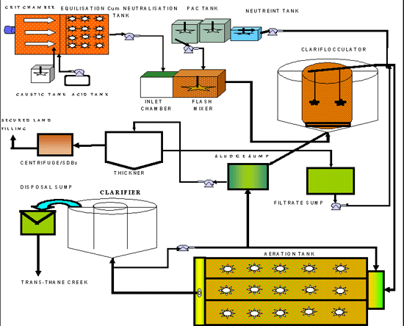
CETP flow Diagram – Thane – Belapur

Slide 15
Hazardous Waste Management Rules, 2016
Rules for Storage, handling, transport, treatment, recycling, disposal, liability (post-closure/ accidental/ incidental) transboundry movement etc.
Authorisation, CHW TSDF by State
Import/Export
Compensation & Liability

Slide 16
HW- Introduction
SC Order, 14.10.2003 accepted grim reality of non-compliance of HW Rules in the country
Realized adverse effects of indiscriminate dumping of HW in India imported from developed countries
SC had constituted High Powered Committee with Prof. MGK Menon, FRS, as its Chairman in 1997
Menon Committee submitted report in Feb, 2002
Taking Cognizance of Menon Committee report, SC passed order, 14.10.2003 & set up SCMC under Chairmanship of Dr. G. Thyagarajan

Slide 17
Impact of SC Order
Removal and safe disposal of HW lying in industrial estates and illegal dumps sites
Reduction in illegal imports of HW
Removal and safe disposal of HW lying at Ports, Polluters Pays Principle
Action plan for rehabilitation/remediation of contaminated sites

Slide 18
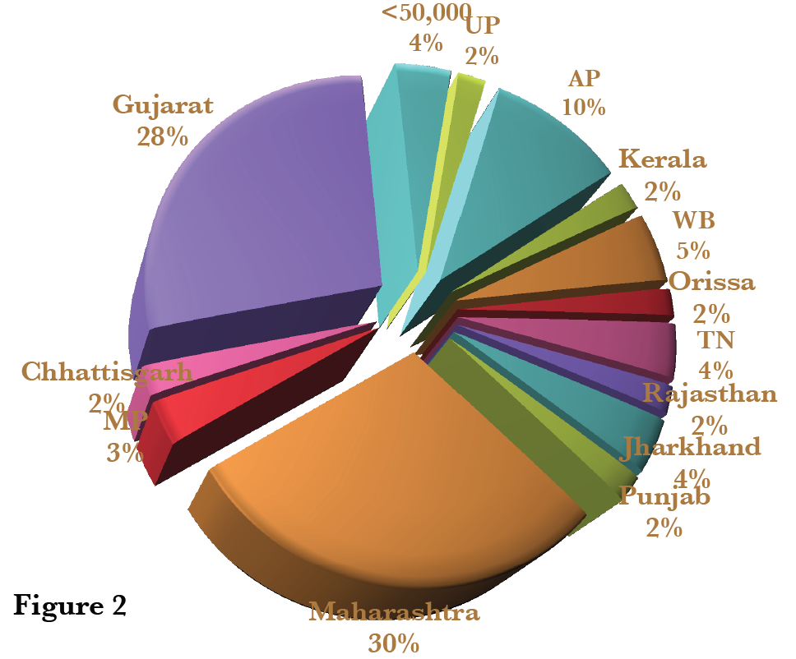

Directions regarding domestic HW (i): National Inventory

Slide 19
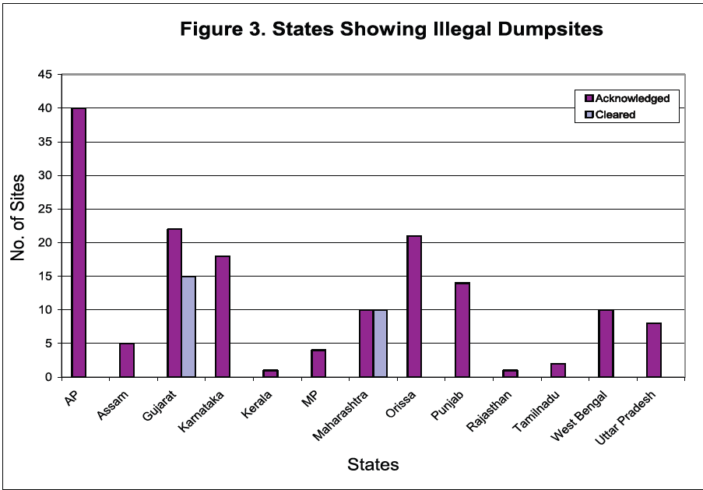
Directions regarding domestic HW (vi): National Inventory of illegal HW dump sites
The Court was seriously concerned with the several illegal HW dump sites and their impact on heath & environment

Slide 20
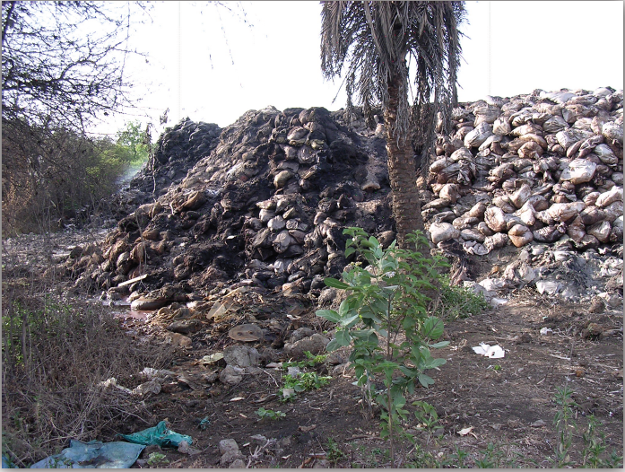
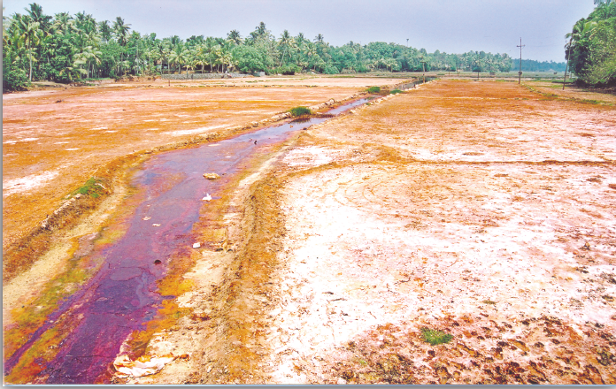
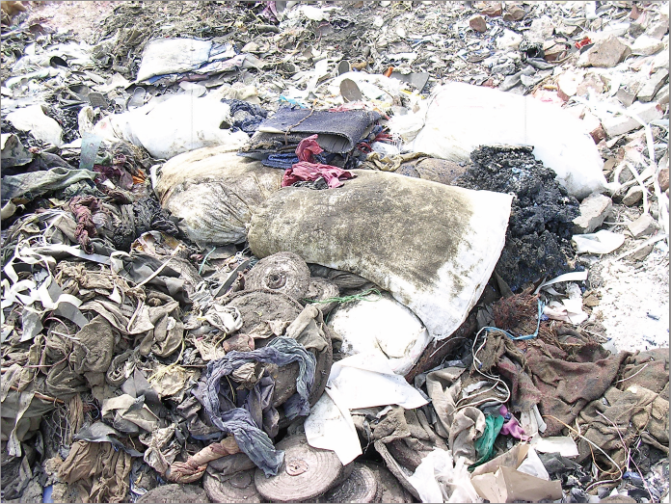
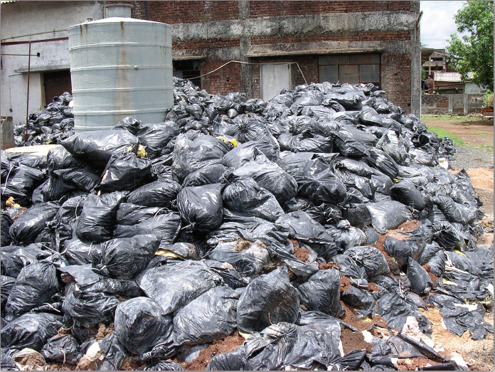
Directions regarding domestic HW National Inventory of illegal HW dump sites
Kerala
Tarapur
Tarapur
Delhi

Slide 21
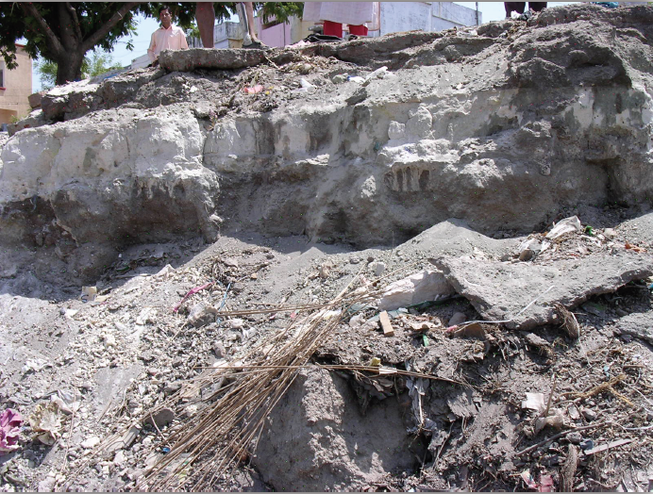
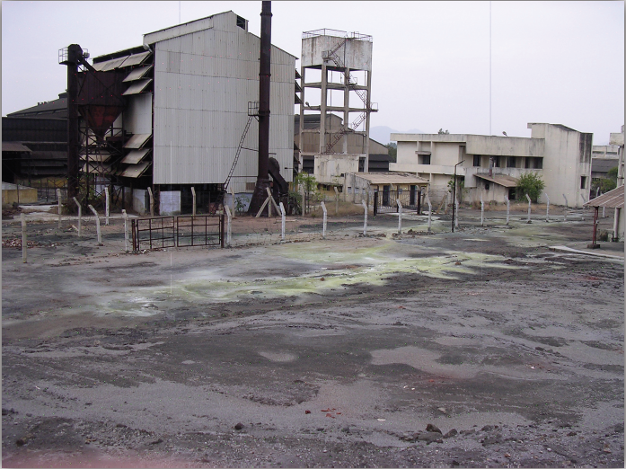
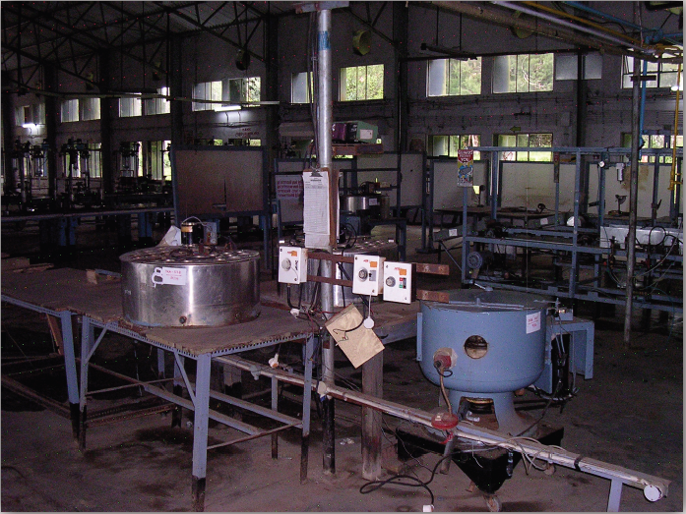
Directions regarding domestic HW National Inventory of illegal HW dump sites
Major Problem HW dumping sites needing special attention
Tamilnadu Chromates & Chemicals - Ranipet
Hema Chemicals - Vadodara
The SCMC was not able to inventorise or get inventorise HW lying abandoned in units that are permanently closed or are under Court receivers in different parts of country
Hindutsan Lever–mercury contamination–Kodaikanal

Slide 22
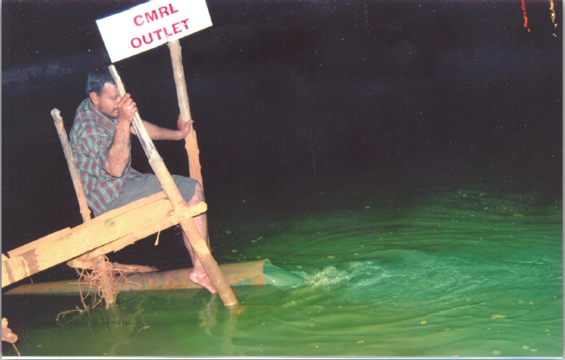
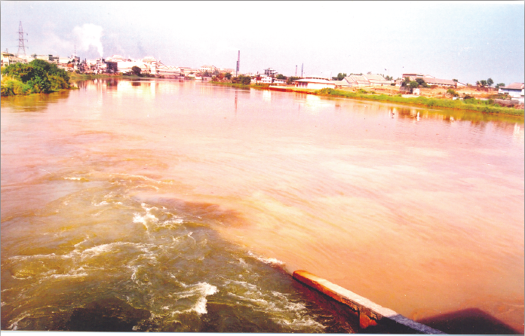
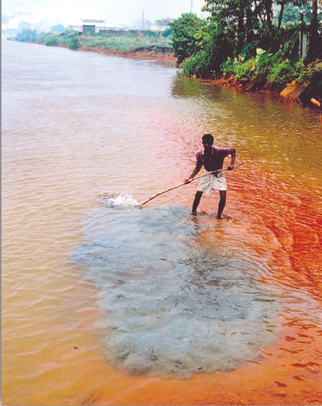
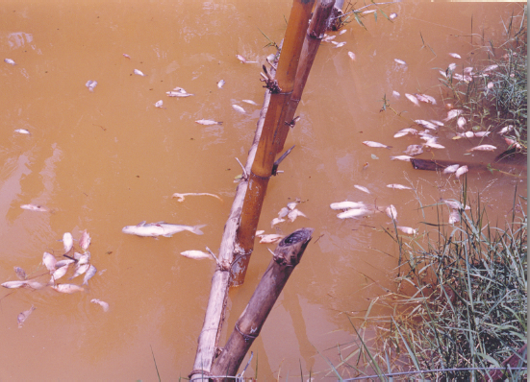
Directions regarding domestic HW National Inventory of illegal HW dump sites
Clean – up of river bed and restoration of life in Periyar river
Discharge of CMRL in Periyar
Periyar River
Fish kill due to toxic effluents in Periyar River, some highly acidic. (Left) a villager demonstrates bluish industrial HW sediments on the river bed which form a cloud on being disturbed

Slide 23
Directions regarding domestic HW National Inventory of illegal HW dump sites
Clean – up of river bed and restoration of life in Periyar river
SCMC brought entire industrial estate to heel
Fined Rs. 2.5 Cr to 247 units to set aside money for rehabilitation of the river. SCMC set up LAEC
Board closed down several industries in coordination with LAEC
Discovered clandestine discharges at night
Undiscovered more than 60 illegal outlets
After a year of these actions pH of the river improved (5-5.5) from a low of 2 (highly acidic)
Representative of fishing community met SCMC to thank the SC for restoring condition of the river and for bringing the fish back into the water body.
At the time of filing report, certain actions still remain to be completed (e.g. – removal of sediment from the river bed)

Slide 24
Directions regarding domestic HW National Inventory of illegal HW dump sites
Polluting industries discharging HW in lakes were ordered to shut. 60 units ordered to move out of the area
STP installed and sewage entering the lake is diverted.
ETPs installed by industries. HW & other solid wastes to TSDF.
Dredging of the lake completed. However, fractured rock bottom was reported. This could lead to leaching in to the GW.
HDPE liners, geotextiles, sand/gravel lining of the lake bottom is not done, although it was part of the WB Funded project.
Since, the cause of contamination has been restricted considerably, natural purification over the years would help restoration to certain extent.
AP Board reported remarkable reversal of the processes affecting the lake due to complete cessation of HW entering water body

Slide 25
Directions regarding domestic HW National Inventory of illegal HW dump sites
Burial of Arsenic waste at Zuari Industries, Goa
Industry was directed to treat and dispose about 450 MT of Arsenic waste in “hermit storage”. Work is completed at the cost of Rs. 70 lacs.
Recommended levy of fine of Rs. 10 lacs for not taking timely steps as per SC Order of 14.10.2003
The “hermit storage” technique of encapsulating the HW was later adopted by SPIC in Tuticorin and others

Slide 26
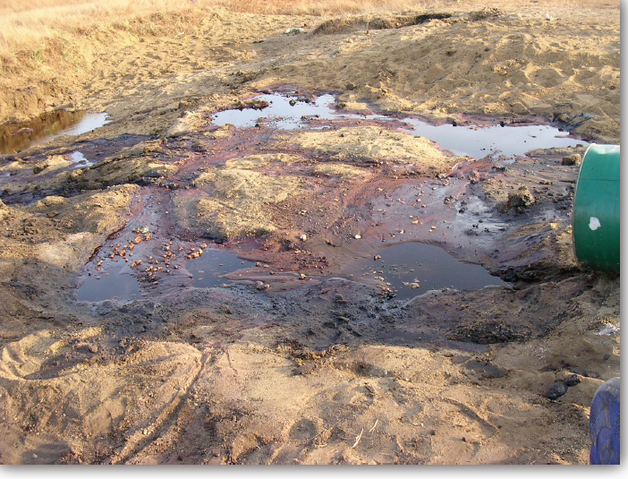
Directions regarding domestic HW National Inventory of illegal HW dump sites
Case of HW dumping by Aventis Pharma in Gujarat
Industry was found discharging HW in agricultural fields. SCMC filed FIR and GPCB ensured closure of the unit.
Rs.25 lacs BG was taken for remediation. GPCB reported satisfactory completion of remediation.
This incident had led to the GPCB recalling and reviewing hundreds of such authorisations and tightening the controls over the movement & disposal of HW.
SCMC travelling through Gujarat was horrified to be taken to these agricultural fields while dumping of extremely toxic solvents was in progress.

Slide 27
Directions regarding domestic HW National Inventory of illegal HW dump sites
Case of Volatile Organic Compounds
In Cuddalore industrial estate (TN) the VOCs were found being discharged into open environment by several industries.
SCMC asked CPCB to evolve necessary standards. This is done now.
Many of the VOCs found in the atmosphere of Cuddalore were found carcinogenic.
Most of the industries were asked to install MEE, RO and CETP.
CETP status ??

Slide 28
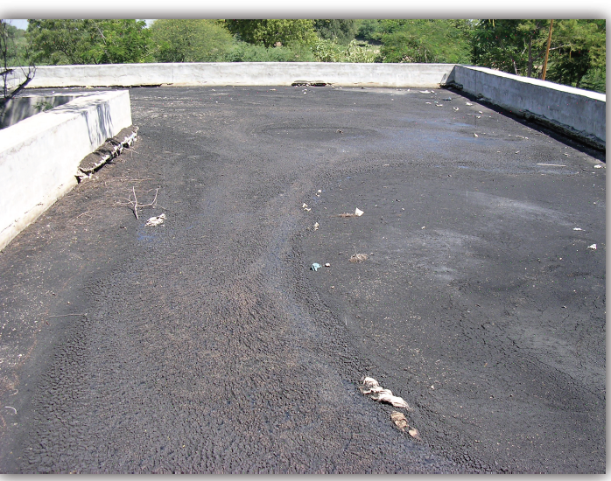
Directions regarding domestic HW National Inventory of illegal HW dump sites
Improvements in CETPs w.r.t HW
23 MLD CETP at the cost of Rs. 18 Cr. completed at Tarapur
10 MLD CETP at the cost of Rs. 7.26 Cr completed with six months at Buti Bori, Nagpur
HW Sludge from CETP at Patancharu and Jeedimetla was sent to TSDF.
Delhi faces a piquant situation. It has CETPs but no TSDF.
SCMC asked SPCBs to tighten the CETP effluent standards and see that HW does not get in to it.
SCMC found huge quantities of sludge accumulated by Patancheru and Jeedimetla CETPs.

Slide 29
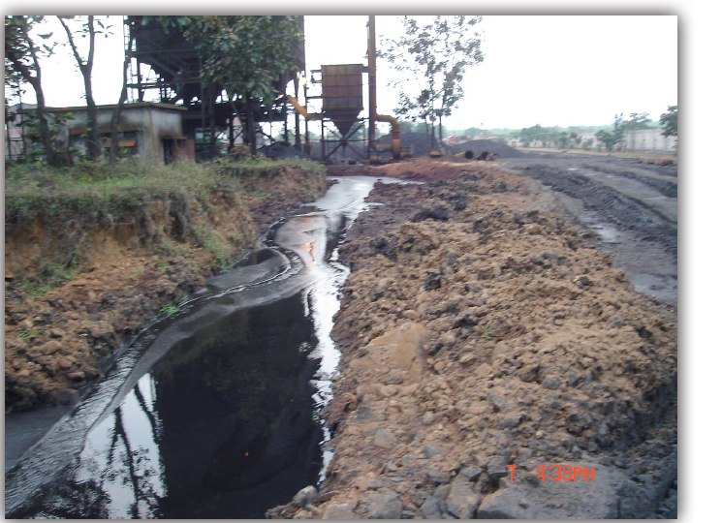
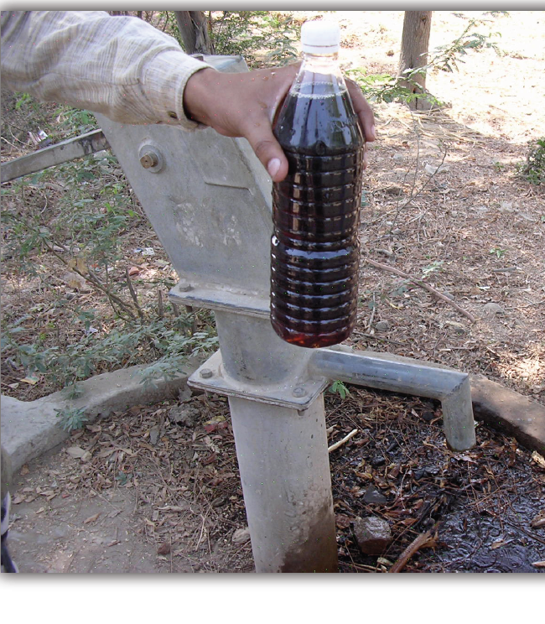
Directions regarding domestic HW National Inventory of illegal HW dump sites
Rehabilitation of contaminated ground water aquifers
SCMC is acutely anxious that in several areas, ground water has been rendered un-potable
There is threat to public health due to the contamination from HW leaching their toxins into soil
Side pics are from Gujarat.
Progress is tardy in this matter.

Slide 30
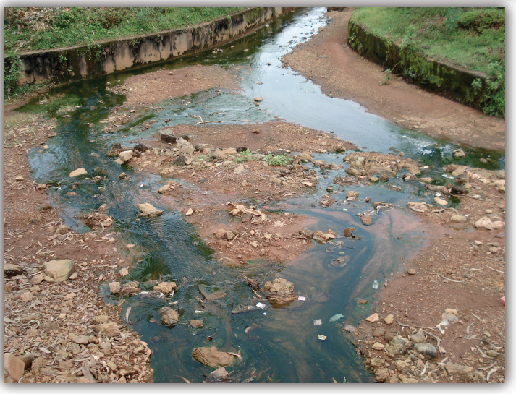
Directions regarding domestic HW National Inventory of illegal HW dump sites
Loss of Ecology
An Authority is urgently required to be set up to ensure that the rehabilitation of abandoned and illegal HW dumps is completed.
SC directed for National Invertory and AP.
MoEF initiated Rs. 1800 Cr. project with WB support in the of NPRPS.
Progress is tardy.

Slide 31
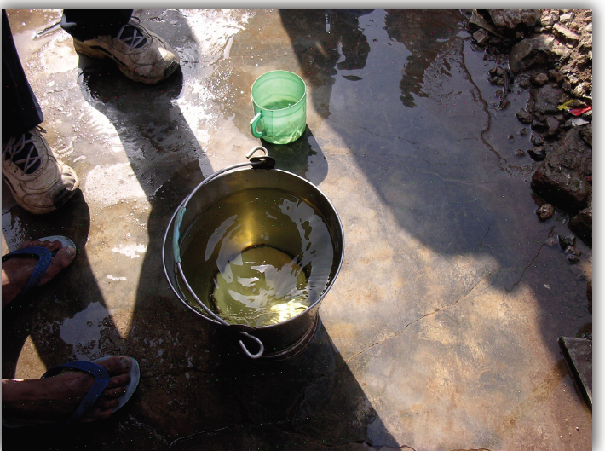
Directions regarding domestic HW Supply of water to communities affected by
ground water contamination due to HW
Faced with the problem of contaminated GW from industrial wastes in Gujarat and MP, the SCMC requested SC to direct the supply of water to the affected communities before the summer of 2004
SC accepted the plea and issued order on 7th May, 2004
In Gujarat , the order was complied for 26 villages at a cost of Rs. 5.5 Cr.
For Bhopal water supply was 40 MLD in affected area around UCIL.

Slide 32
Directions regarding Imported HW & Basel Convention:
Disposal of HW impounded at Ports and ICDs
Consignments of waste oils lying at Tuticorin incinerated under TNPCB
HW at ICD Bangalore sent to TSDF after solidification
47 containers of waste oil at MbPT incinerated at TSDF Taloja
DPCC in association with CPCB was asked to verify HW lying at ICD Tuglakhabad and decide disposal options
Punjab PCB in association with CPCB was asked to verify and decide in respect HW lying at Ludhiana ICD
Commissioner of Customs, Mumbai was asked to verify and confirm the quantity of HW lying in JNPT and then decide disposal options in consultation with MPCB

Slide 33
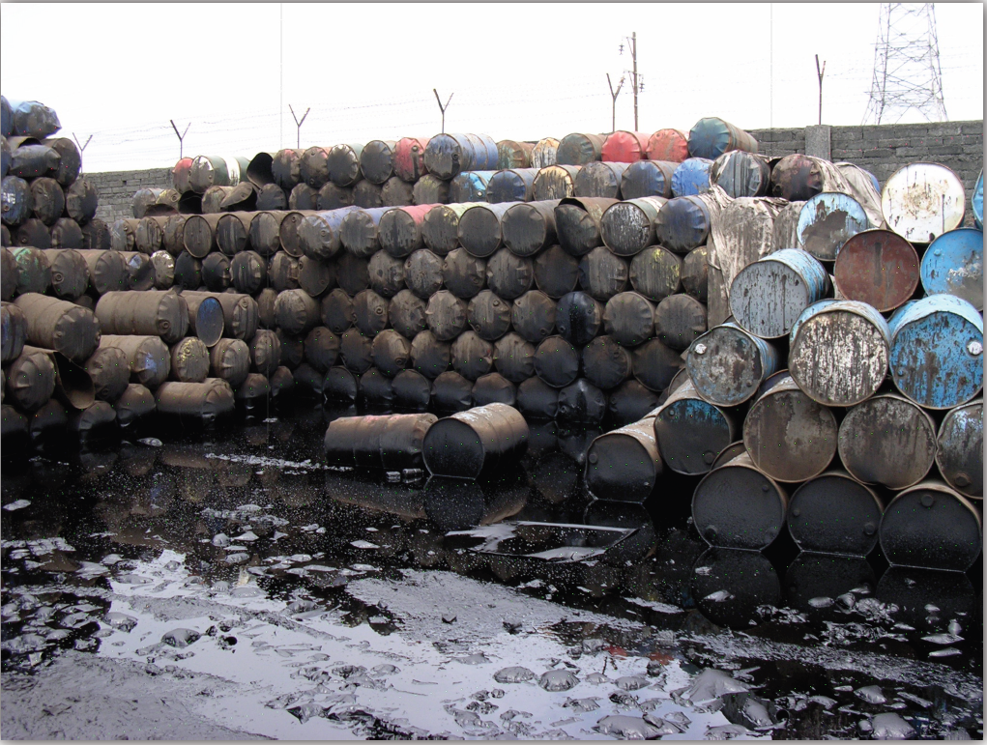
Directions regarding Imported HW & Basel Convention:
(iii): Destruction by Incineration of 133 containers of waste oil illegally imported at JNPT ( SC Order dated 5.01.2005)
133 Containers moved to TSDF Taloja
SCMC sub-committee supervised
MPCB ensured that incineration followed norms
Cost of incineration Rs. 2.86 Cr. Paid by Customs

Slide 34
Conclusion (SCMC) Achievable vision for effective & total management of HW
Considering the gravity of the scenario depicted by the Menon Committee the Court passed a comprehensive order, which among other things, required authorities concerned to :
Prepare Nation-wide Inventory of Polluted Sites
National Program for Rehabilitation of Polluted Sites.
Ensure clean up of illegal HW dumps
This has resulted in formulation and implementation of National Program for Rehabilitation of Polluted Sites by MoEF& CC .

Slide 35
National Programme for Rehabilitation of
Polluted Sites: NPRPS
What is NPRPS
The National Program for Rehabilitation of a Polluted Site (NPRPS) is a framework for scaling up followed by the clean up and rehabilitation of polluted sites and facilitate the reduction of environmental and health risks associated with the legacy of polluted sites.
There are 3 major activities under NPRPS which the MoEF&CC took up with financial assistance from the World Bank.
Inventory and Mapping of Probably Contaminated Sites,
Development of Methodologies for NPRPS and
Development of the NPRPS.
The NPRPS reviews and updates the available information on polluted.

Slide 36
National Programme for Rehabilitation
of Polluted Sites: NPRPS
How it was done
There are fourteen Steps in the site assessment and remediation process which are divided into four groups.
Identification
Step 1: Identification of probably contaminated sites
Step 2: Preliminary investigation
Step 3: Notification of polluted site
Step 4: Priority list addition
Planning
Step 5: Remediation investigation
Step 6: Remediation Design, DPR
Step 7: DPR approval and financing

Slide 37
National Programme for Rehabilitation
of Polluted Sites: NPRPS
How it was done
Implementation
Step 8: Implementation of remediation
Step 9: Approval of remediation completion
Post remediation
Step 10: Post remediation plan
Step 11: Post remediation action
Step 12: Cost recovery
Step 13: Priority list deletion
Step 14: Site reuse

Slide 38
National Programme for Rehabilitation
of Polluted Sites: NPRPS
What NPRPS include
Review the nature and type of hazardous waste polluted sites in India
Overview of international practices
Review of national and international approaches to remediation
Review of current systems
Identify Options and recommend standards for remediation of polluted sites
…continued

Slide 39
National Programme for Rehabilitation
of Polluted Sites: NPRPS
What NPRPS include
Develop Guidance Document on Methodology for Design,
Implementation and Monitoring of Remediation Plans
Identify options for legal and institutional strengthening
Stakeholder Consultations
Identify capacity building requirements
Prepare a plan for the implementation of NPRPS

Slide 40
National Programme for Rehabilitation
of Polluted Sites: NPRPS
State-wise Action Sites
State | Number of Sites |  | State | Number of Sites
Andhra Pradesh | 1 |  | Madhya Pradesh | 5
Assam | 1 |  | Maharashtra | 3
Bihar | 1 |  | National Capital Territory | 6
Chhattisgarh | 2 |  | Orissa | 22
Goa | 1 |  | Punjab | 6
Gujarat | 9 |  | Rajasthan | 2
Haryana | 3 |  | Tamil Nadu | 5
Himachal Pradesh | 1 |  | Uttar Pradesh | 16
Jharkhand | 2 |  | Uttarakhand | 1
Karnataka | 5 |  | West Bengal | 4
Kerala | 4 |  | Total | 100

Slide 41
National Programme for Rehabilitation
of Polluted Sites: NPRPS
Status of NPRPS today
Inventory and Mapping of Probably Contaminated Sites, Development of Methodologies for NPRPS and its Notification under the EPA, 1986, for implementation issued by MoEF&CC.
Guidelines are in place.
Pilot NPRPS activity is ongoing at:
Noor Mohammad Kunta site in Andhra Pradesh
Kadappa in Andhra Pradesh
Dhapa in West Bengal

Slide 42
National Programme for Rehabilitation
of Polluted Sites: NPRPS
Few examples of remediation/restoration In Maharashtra
> 4,50,000 MT of HW lying at various industrial sites was removed by the SPCB order, followed by excavation of contaminated soil, its treatment and safe disposal was done in several cases such as Mahesh Chemicals, Golden Chemicals, TATA Motors, Glen Mark etc. Cost recovered from industries by SPCB.
> 40,000 MT of hazardous chemicals sludge from the tank bottoms of CETPs from MIDC was removed and disposed safely. Cost recovered.
2,25,000 MT of HW dumped at MIDC Tarapur was excavated. SLF constructed at site. Safe disposal completed under the directions of NEERI. Cost recovered from MIDC by SPCB.
133 containers of hazardous waste oil seized by Customs and lying at JNPT were removed, site scrapping done and waste disposed by incineration at TSDF. Cost recovered from Customs.

Slide 43
Hazardous Waste Treatment Options: BURRY OR BURN
Landfill
Direct Landfill
Landfill after treatment
Incineration
Direct Incineration
Incineration after treatment
Storage – Intractable
Alternate Destruction Technologies
praveenmjadhav@gmail.com

Slide 44
Solution to the Problem
Treatment
Storage
Disposal
Landfill and Incineration are Internationally proven Destruction Technologies
smalgar@ramky.com

Slide 45
Laboratory
Accredited by Ministry of Environment & Forest, India
The first task is waste characterisation.
The principle is to know the waste. This is necessary to decide on the right and economic method of handling, storage and disposal. It is a vital function to ensure safety .
Laboratory alone can decide on the acceptance criteria.
Laboratory is to continuously work to suggest the improvements required in the process & system of waste handling & disposal.
Laboratory acts as the hub for implementation & establishment of ISO systems and audits thereof.

Slide 46


CA
Comprehensive Analysis
Corrosive- Flammable- Toxic- Reactive
Methods
Physical - Colour - Texture
US EPA SW-846
APHA
Calorific Value - Flash Point
LOD - LOI - Specific Gravity
Hazardous Waste and Other waste Management [Management & Handling] Rules 2016
Schedule – 1 -- List of HzW
Schedule – 2 -- Concentrations
Schedule – 5 -- Used Oil
Schedule – 6 -- Waste Oil
pH - NH₃ - PO₄ - PFLT
Cyanide - Sulfide
Sulphates - Chlorides
Inorganic Total & TCLP
Identification of Organics
CRIT Criteria
Corrosive
Toxic
Reactive
Ignitable

Slide 47
DISPOSAL METHODS
DLF
DIRECT LANDFILL
LAT
LANDFILL AFTER TREATMENT
INC
INCINERATION

Slide 48
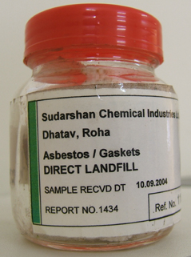
CPCB Landfill Disposal Criteria
Calorific Value | Less than 2500 cal/gm
Flash Point | > 60 deg C
pH | Between 4 to 11
Organic Content | Less than 20 %
PFLT Test | Pass
Reactive Cyanide | Below Detectable Limit
Silt Sludge
ETP Sludge
Lime Sludge
Inert Material
Insulation Material
DLF
DIRECT LANDFILL

Slide 49
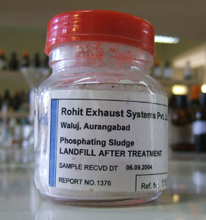
Landfill After Treatment
Acidic Waste
Cobalt Waste
Iron Waste
Cyanide Waste
Sulphur Waste
Nickel Waste
Copper Waste
Zinc Waste
Barium Waste
Chromium waste
Phosphating Sludge
Mercury Bearing Waste
Lead bearing Waste
Heavy Metal Bearing Sludge
LAT
LANDFILL AFTER TREATMENT

Slide 50
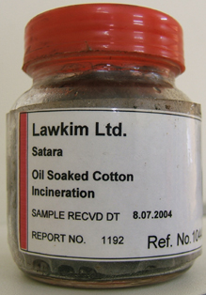
Incineration
Paint Sludge
Tarry Waste
Waste Oil
Used Oil
Oil Sludge
Solvent Waste
Cotton Waste
Carbon Waste
Spent Resins
Distillation Residue
Pharma Products & Waste
INC
INCINERATION

Slide 51


FPA
Finger Print Analysis
FPA is done to check the waste characteristics Vis-à-vis Comprehensive Analysis submitted by the Generator
Key Parameters
pH
Calorific Value
Flash Point
Cyanide
Sulfide
LOD @ 105 Deg C
LOI @ 550 Deg C
Specific Gravity
Chemical Compatibility
Paint Filter Liquid Test
other parameters on merit
f
inger print analysis

Slide 52
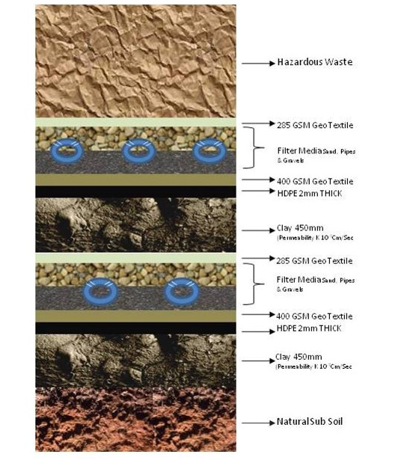
Landfill Design
Hazardous Waste Landfill Cross Section
(Double Composite Base Liner System)

Slide 53
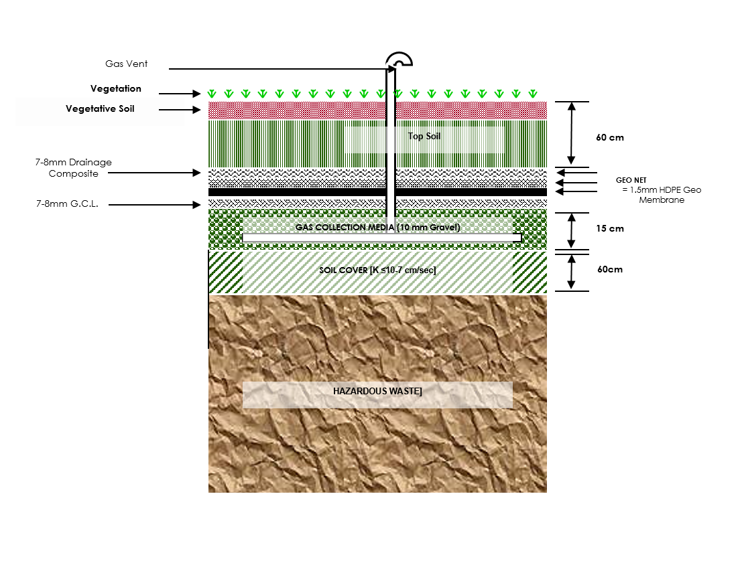
Landfill Design
HAZARODUS WASTE LANDFILL CROSS SECTION
(COVER SYTEM)
225 gsm GEOTEXTILE

Slide 54
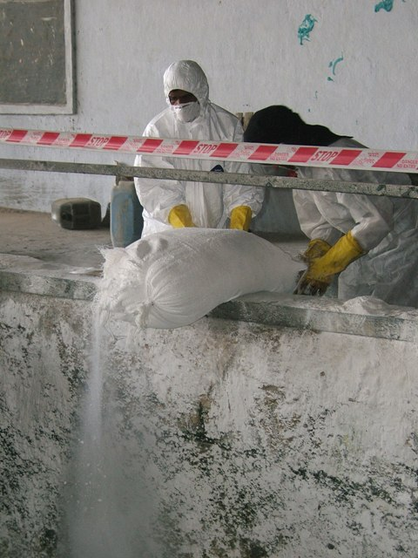
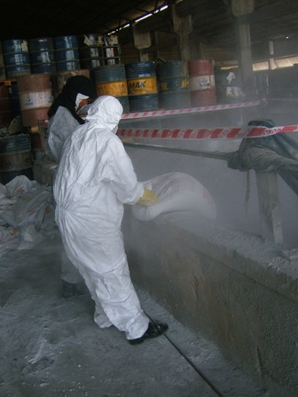
Waste Treatment

Slide 55
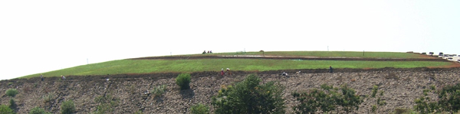
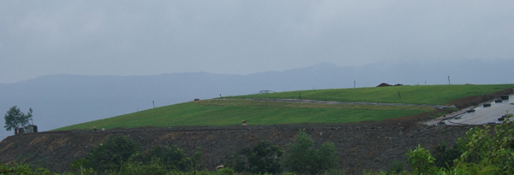
Land Capping

Slide 56
HW Incinerator
ROTARY KILN WITH EVAPORATIVE COOLER
Bag Filter
Wet Scrubber
Evaporative Cooler
Reagent Feeding
ID Fan
SCC
35 m Stack
Rotary Kiln

Slide 57
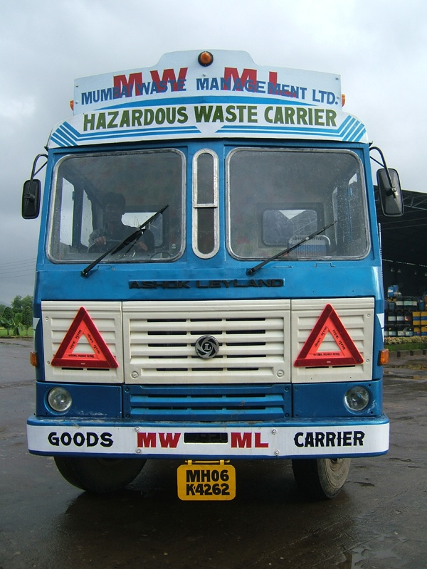
HW Transportation
Transportation is done by containerized vehicles to ensure compliance with Hazardous Waste Transportation Guidelines & to have operational control on this vital activity.

Slide 58
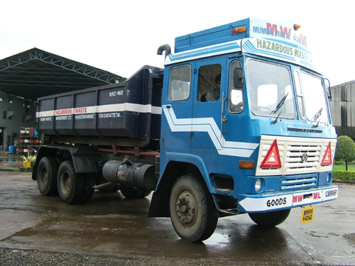
HW Transportation

Slide 59
Safety Rules to be followed by Generator
Never assume a waste to be non hazardous
Do not encourage manual Handling of waste
Get the MSDS of Hazardous component of your waste
Educate your staff about the risk involved in handling the waste
Use the safety equipments like Gloves, Mask, Safety Goggles,safety shoes and aprons while handling the waste
Segregate the waste storage area In your premises and restrict unauthorized entry in such area.

Slide 60
Health Effects of Hazardous Waste
Acute Effects can be observed in Handling High Toxicity waste - usually the generator is aware of risks involved in handling such waste – Ex: Cyanide bearing waste – and takes adequate precaution.
Chronic Effects – long term effects – can be observed in low/ moderate toxicity wastes.
Usually the generator is not aware of health hazard posed by this waste eg. Asbestos, Chromium bearing waste, lead bearing waste
The effects of these wastes can span across generations – eg. Accumulation of Pb can result in infertility, mentally challenged offspring.
The chronic health hazardous have to be documented carefully by the generator by keeping track of Health problems of the employees.

Slide 61
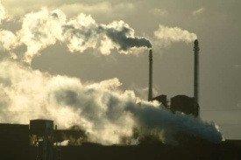

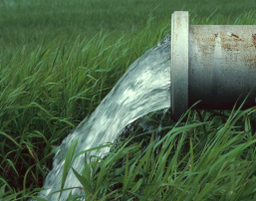
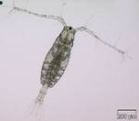
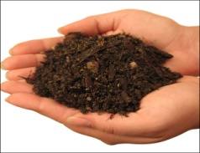
ENVIRONMENTAL MONITORING
AIR
NOISE
WATER
BIOLOGICAL
LAND

Slide 62


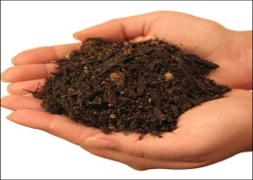
5 components of Environment to be monitored regularly.
Ground Water
Surface Water
Drinking Water
Once in Fortnight
Leachate
Ambient Air
Twice in Week
Stack
Once in Fortnight
Noise – Once in Week
Land - Once in month 6 soil samples
Biological – Every week bioassay on local fish

Slide 63
Bio Medical Waste Management:
OBJECTIVES: To improve the collection, segregation, processing, treatment and disposal of bio-medical wastes in an environmentally sound management.
BIO MEDICAL WASTE ?
It is defined as “any waste, which is generated during the diagnosis, treatment or immunization of human beings or animals or research activities pertaining thereto or in the production or testing of biological or in health camps including the categories mentioned in Schedule I appended to BMW rules 2016.
“Any solid and/or liquid waste including its container and any intermediate product, which is generated during the diagnosis, treatment or immunization of human beings or animals:

Slide 64
Status of Implementation of Bio-medical waste Management Rules
1. | Total no. of Healthcare Facilities (HCF) | 1,88,098*
2. | Total no. of Beds | 17,61,316
3. | No. of Common Bio-medical Waste Treatment Facility (CBWTF)/Private Agencies | 203 (32 Under Construction) *
4. | No. of HCFs which are utilizing CBWTFs/ Private Agencies | 1,51,854*
5. | No. of HCFs having on-site treatment and disposal facilities | 21,462*
6. | No. of HCFs (treating 1000 patients per month) require Authorization under BMW Rules from SPCBs/PCCs/DGAFMS) | 1,42,916*
7. | No. of HCFs Obtained Authorization under BMW Rules from SPCBs/PCCs/DGAFMS) | 99,650*
8. | Total Quantity of BMW generation in Tons/day | 501 *
9. | Total Quantity of BMW Treated in Tons/day | 487*
* All States/UTs have not provided desired information

Slide 65
Bio-medical waste management rules, 2016
Provisions
Application
Definitions ( from a to p)
Duties of the Occupier / Facility Operator and Authorities
Procedures for Segregation, Packing, Transportation, Storage, Treatment and Disposal
Procedure for Authorization
Advisory Committee and Monitoring Committee
Reporting Requirements
Maintenance of Records
Accident Reporting
Appeal
Procedure for setting up CBWTDF
Liability of the occupier, operator of a facility

Slide 66
Application
These Rules shall apply to all persons who generate, collect, receive, store, transport, treat, dispose or handle bio-medical waste in any form including:
Hospitals,
Nursing homes,
Clinics,
Dispensaries,
Veterinary institutions,
Animal houses,
Pathological laboratories,
Blood banks,
Ayush hospitals,
Clinical establishments,
Research or educational institutions,
Health camps,
Medical or surgical camps,
Vaccination camps,
Blood donation camps,
First aid rooms of schools,
Forensic laboratories and research labs

Slide 67
Bio-medical waste management rules, 2016
Schedules
Schedule I – Bio-medical Wastes categories and their segregation, collection, treatment, processing and disposal
Schedule II – Standards for treatment and disposal of bio-medical wastes
Schedule III – List of Prescribed Authorities and Corresponding duties
Schedule IV – Label for Bio-medical Waste Containers or Bags
Forms
Form I – Accident Reporting
Form II – Application for Authorisation or Renewal of Authorisation
Form III – Authorisation
Form IV – Annual Report
Form V – Application for filing appeal against order passed by the Prescribed Authority

Slide 68




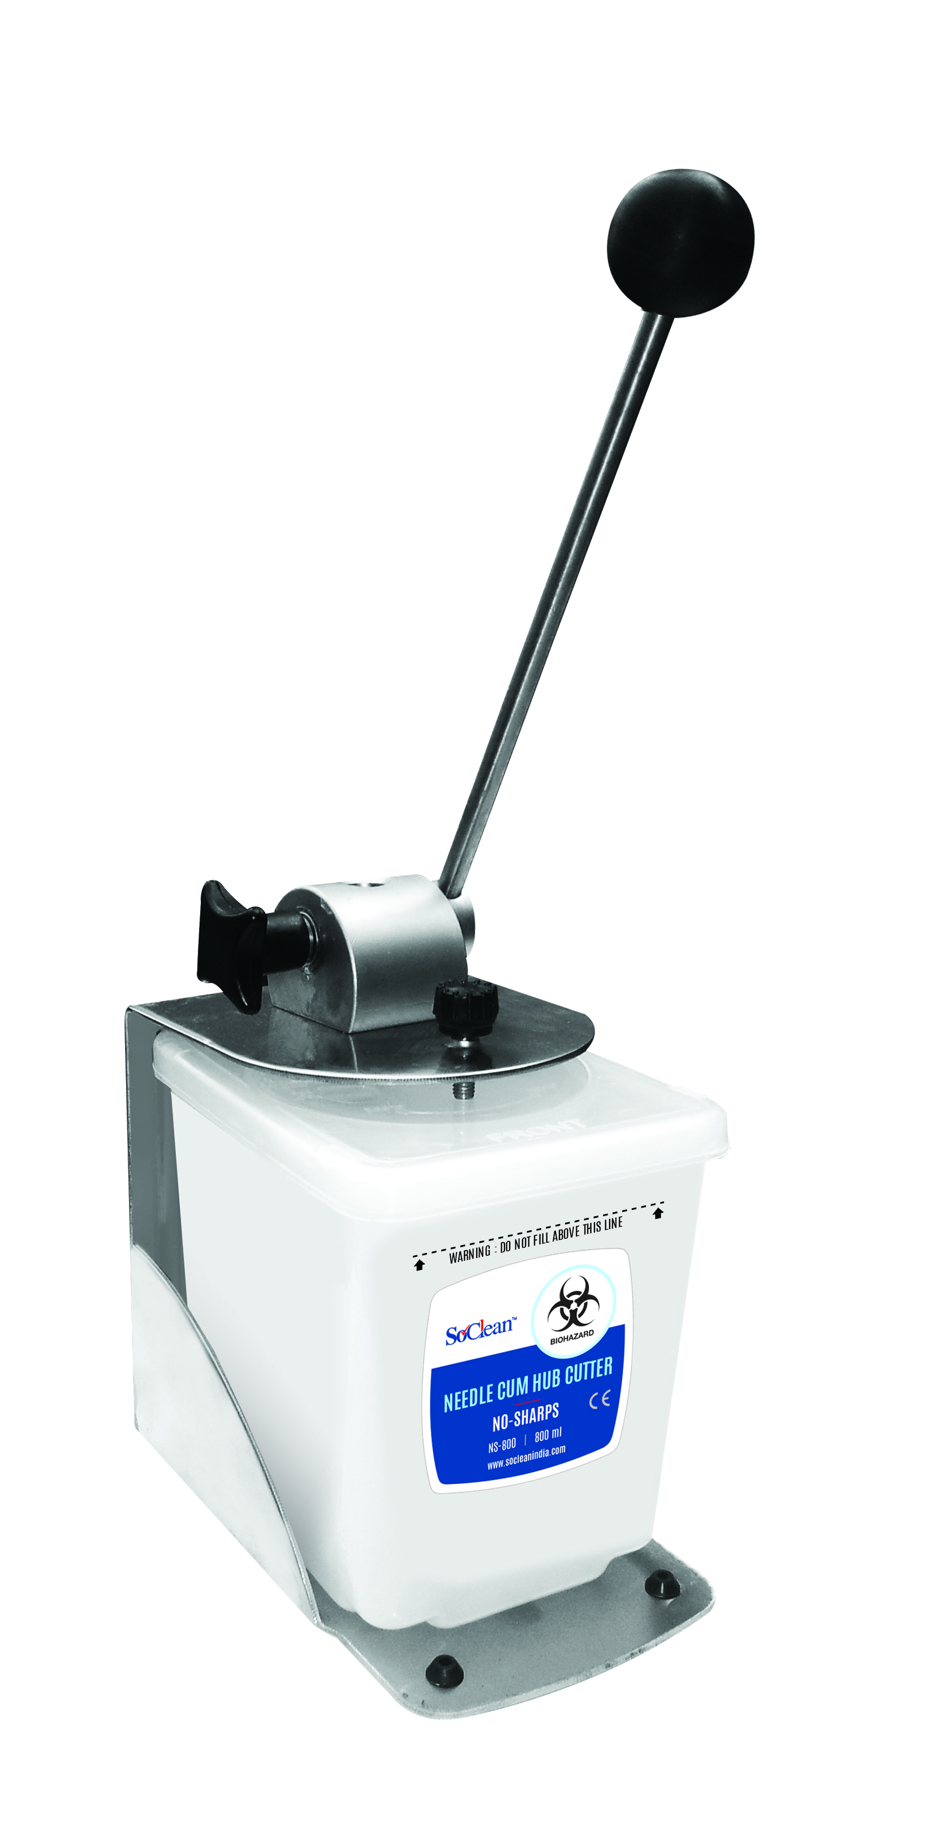
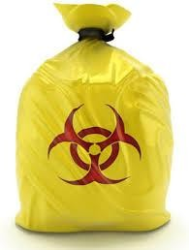
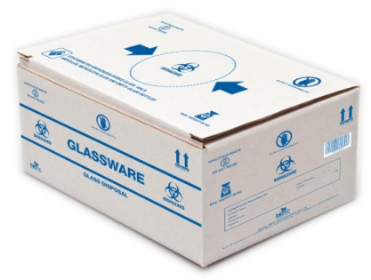
BIO -MEDICAL WASTE MANAGEMENT- SEGRAGATION
Human anatomical waste,
Chemo drugs
Soiled waste
Expired or Discarded Medicines, soiled linen
G Glassware:
Broken or discarded
and
contaminated glass including medicine vials
and ampoules ssware:
Contaminated Plastic Waste (Recyclable)
Waste sharps including Metals

Slide 69
Treatment & Disposal
BMW shall be treated & disposed of in accordance with Schedule I & II
Occupier shall handover the segregated BMW to CBWTF including pre-treated lab and highly infectious waste for further treatment. Efficacy: Log4 for Disinfection and Log 6 for Sterilization.
No Occupier shall establish captive treatment facility if CBWTF is located at 75 Km. If services of CBWTF not available, occupier shall setup captive treatment facility as per authorization from SPCB.
Every occupier shall phase out use of chlorinated plastic bags within two years.
The bags used for handling of BMW should be as per BIS Specifications (to be formulated) till such time as per PWM Rules, 2016 (i.e., = or > 50 µ thick)
After treatment, the recyclable BMW shall be given to recyclers authorized / registration from Prescribed Authority
Handling and disposal of mercury waste and lead waste shall be in accordance with the respective rules / guidelines

Slide 70
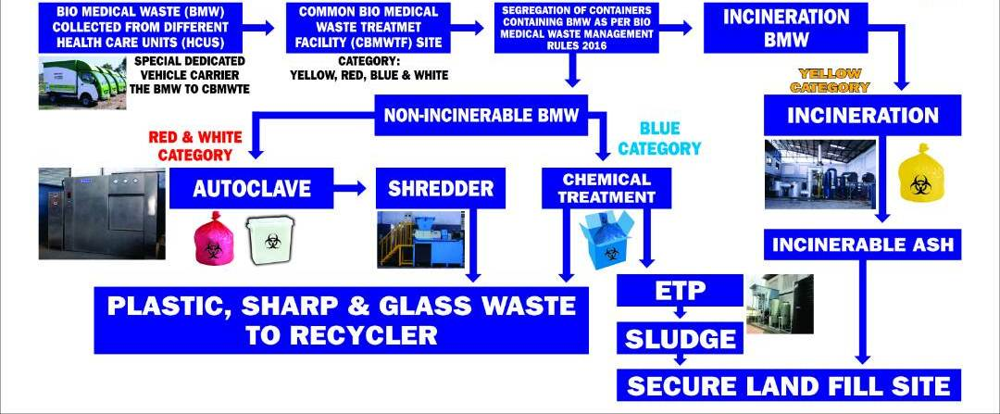
TREATMENT AND DISPOSAL AT CBMWTF

Slide 71
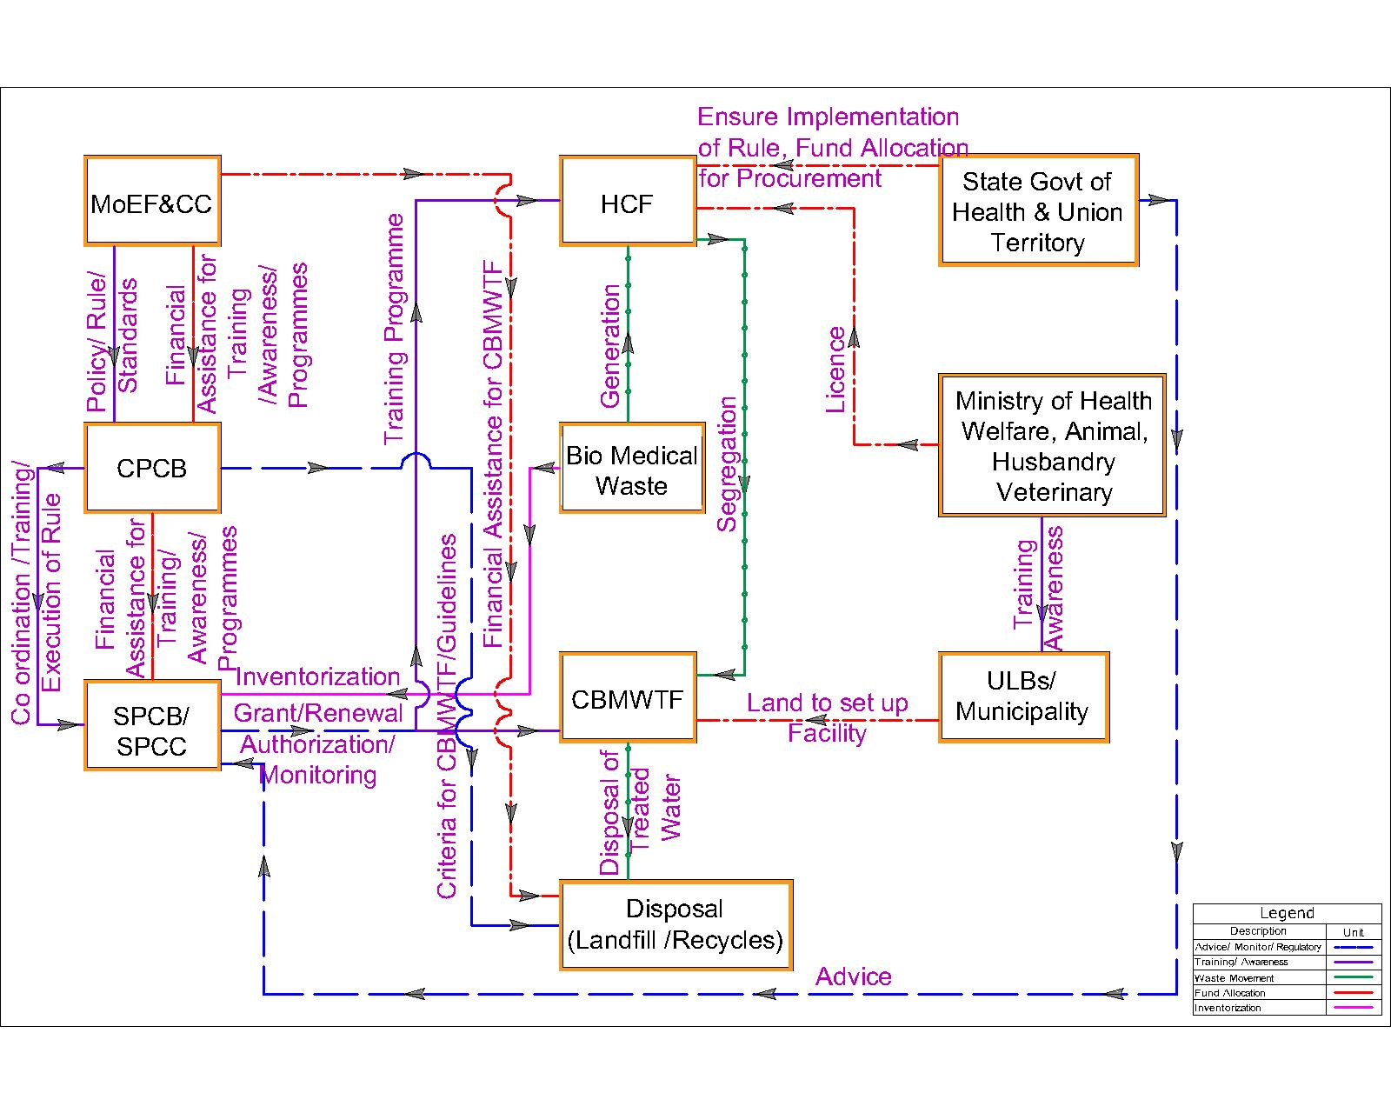
Regulation FLOW CHARTBMW

Slide 72
Other wastes
E- Waste
Plastic Waste
C&D Waste
Lead Acid Battery Recycling
Coastal Zone Management
Transboundary movement of wastes
Bio Medical wastes

Slide 73
THANK YOU
Dr. Dilip Boralkar
Email: dbboralkar@gmail.com
Website: www.boralkar.com
Cell No. +91-9892542288

